Slide 1


This is Black codes Representing
RAJALAKSHMI INSTITUTE OF TECNOLOGY

Slide 2

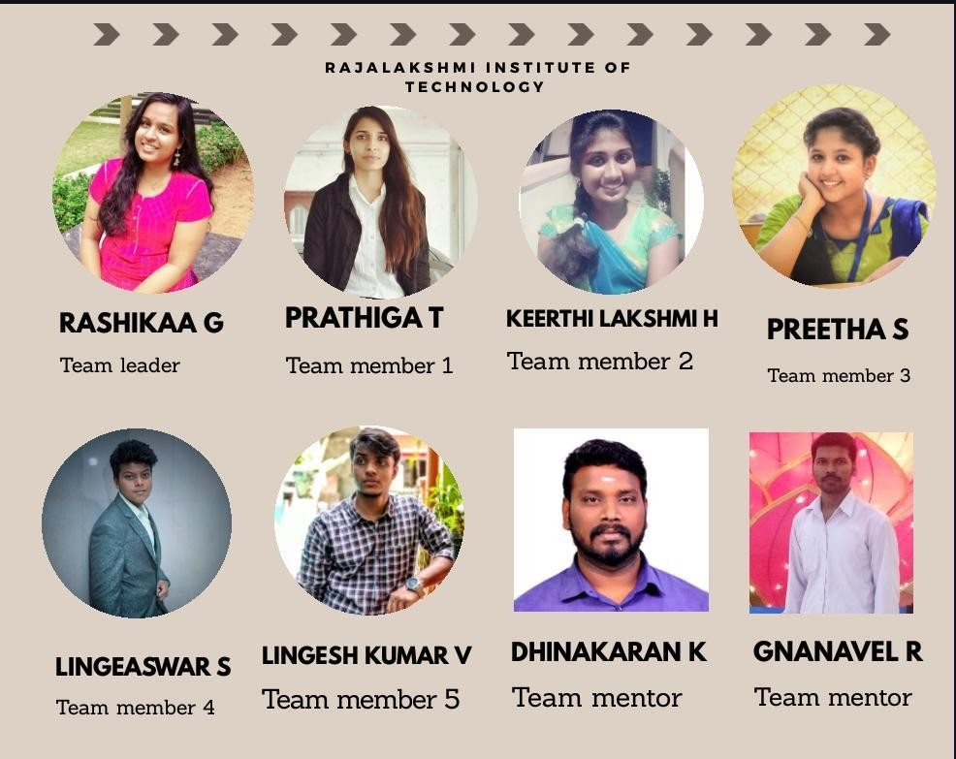
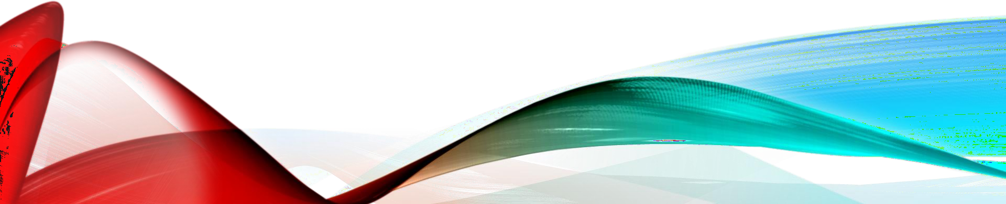

Slide 3
REAL TIME CROP MONITORING USING ARTIFICIAL INTELLIGENCE

Slide 4






CONTENT
Problem statement
About
Abstract
Use case
Dependencies and Purpose
Topics
Google Earth Engine

Slide 5
PROBLEM STATEMENT
Develop a real time land usage monitoring tool using Satellite data and Artificial Intelligence

Slide 6
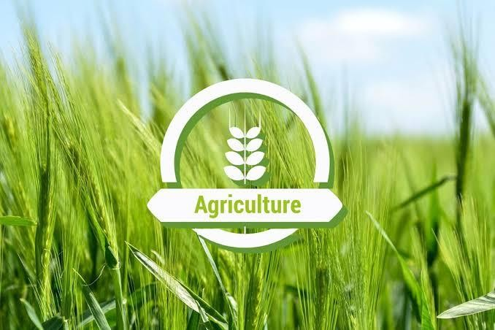
ABOUT
This project demonstrates the capabilities of field monitoring ,crop growth analysis and yield
prediction with the help of satellite imagery .

Slide 7
ABSTRACT
The temperature change and its unpredictability, has caused majority of the agricultural crops in production and maintenance.
Forecasting or predicting the crop yield well prior to its harvest time would assist the farmers for taking appropriate measures for mercantilism and storage.
Correct prediction of crop development stages plays a crucial role in crop production management.

Slide 8
Crop monitoring and forecasting of crop yields for the proposed system are going to be dole out via satellite pictures with low resolution.
The combination of extensive and extended topographic coverage and its high temporal frequency build these pictures an appropriate choice for the prediction of crop yields and these pictures are trained using artificial intelligence.
The paradigm distinguishes between crops, the infrared and temperature bands of pictures taken throughout apex season contribute the foremost to the crop prediction.
The main aim is to match the output of crops to verify whether or not the results are correct for crop yield forecasting then these output are going to be displayed in the map.

Slide 9
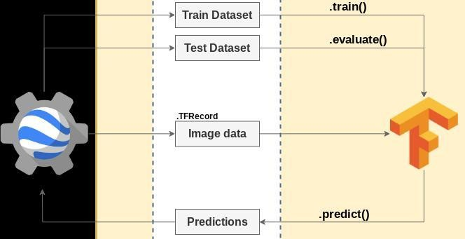
USE CASE

Slide 10
DEPENDENCIES
Earthengine-api , OS , Pandas , urllib , plotly,
bumpy , folium
Technological stacks:k means clustering and
Google Earth engine code editor
PURPOSE
GEE integration
It shows the step by step how to integrate Google Earth Engine and TensorFlow 2.0 in the same pipeline (EE->Tensorflow->EE).

Slide 11
TOPICS
Create a training/testing dataset (in a TFRecord format) using Earth Engine.
Create functions for parse data (TFRecord -> tf.data.Dataset; Decode the bytes into an image format).
Shuffle, repeat and batch the data.
Training and Test a Convolutional Neuronal Network
using tensorflow 2.0.
Making predictions on image data exported from
Earth Engine in TFRecord format.
Upload your results to Earth Engine (asset).

Slide 12
GOOGLE EARTH ENGINE
It is a platform that combines a multi-petabyte catalog of satellite imagery with planetary-scale analysis capabilities. There are several ways to interact with GEE:
There are several ways to interact with GEE:
the Python wrapper library (used in this post) is the best choice to interact with GEE for the following reasons:
Easy to share code.
Easy transition to a web application.
Possibility to integrate with ML/DL frameworks.
Many plotting options (folium, plotly, matplotlib, seaborn ,etc.).
it's possible to run the Earth Engine Python API in a cloud environment for free.

Slide 13
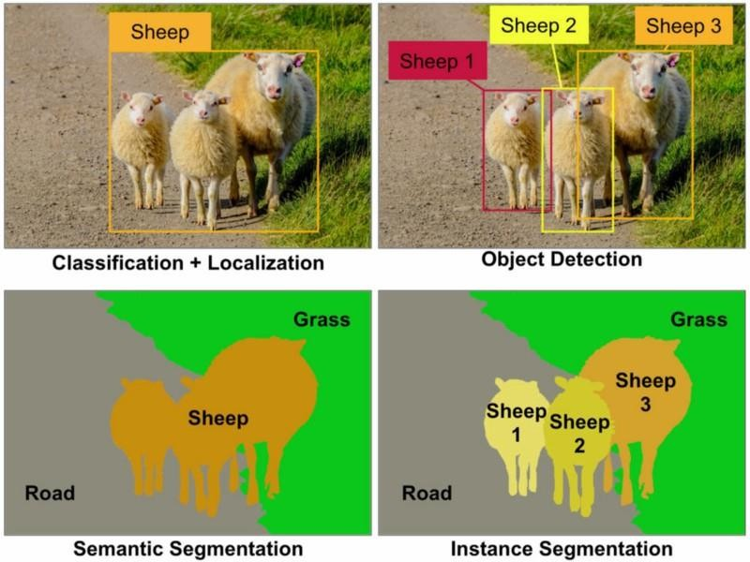
U-NET
There are various levels of granularity in which the computers can gain an
understanding of images.
For each of these levels there is a problem defined in the Computer
Vision domain.
Starting from a coarse grained down to a more fine grained
understanding we can identify the following problems.
Classification with Localization
Object Detection
Semantic segmentation
Instance segmentation

Slide 14
One of the most popular state-of-art CNN used in semantic segmentation is the U-Net (it will be used in this post) initially developed for biomedical image interpretation.
This network is a slight modification of the fully convolutional network
(FCN).
The main steps for building a U-net are:
Create the dataset considering patch of 256x256.
Visualize data/perform some exploratory data analysis.
Set up data pipeline and preprocessing.
Initialize the model's parameters.
Loop:
Calculate current loss (forward propagation) :
Calculate current gradient (backward propagation)
Update parameters (gradient descent)

Slide 15
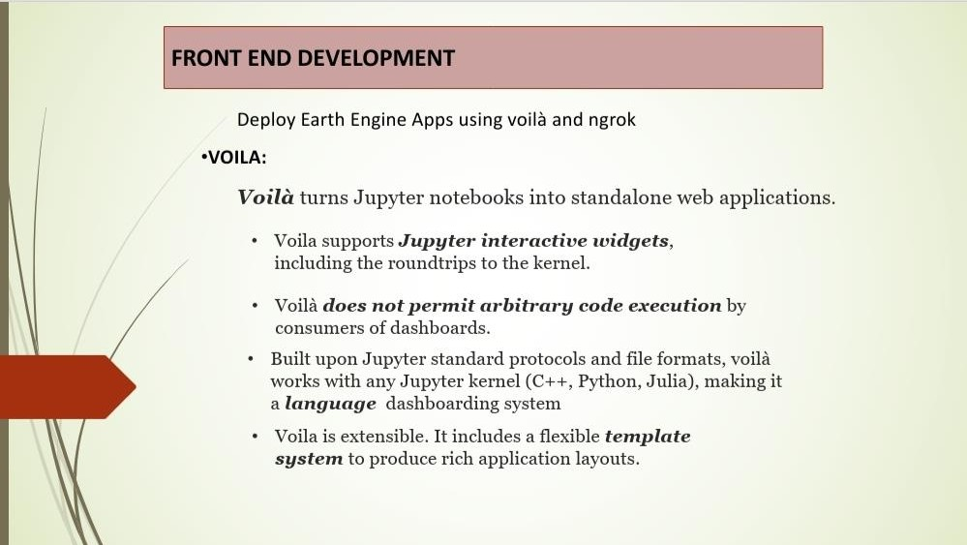

Slide 16
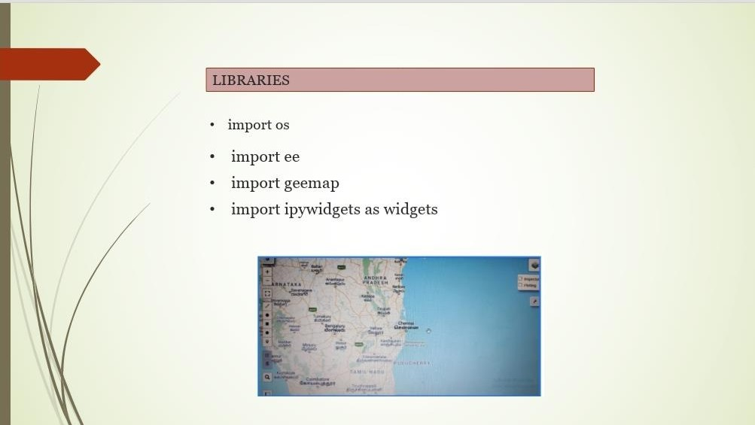

Slide 17
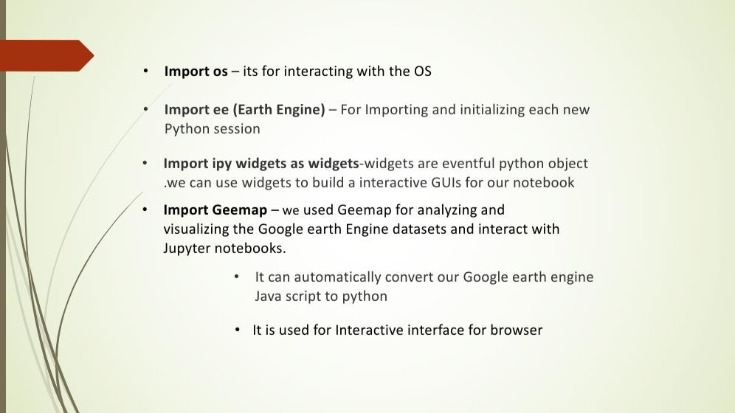

Slide 18
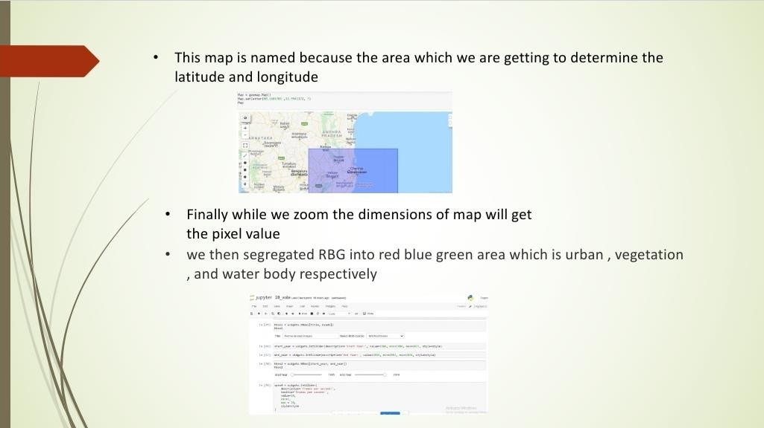

Slide 19
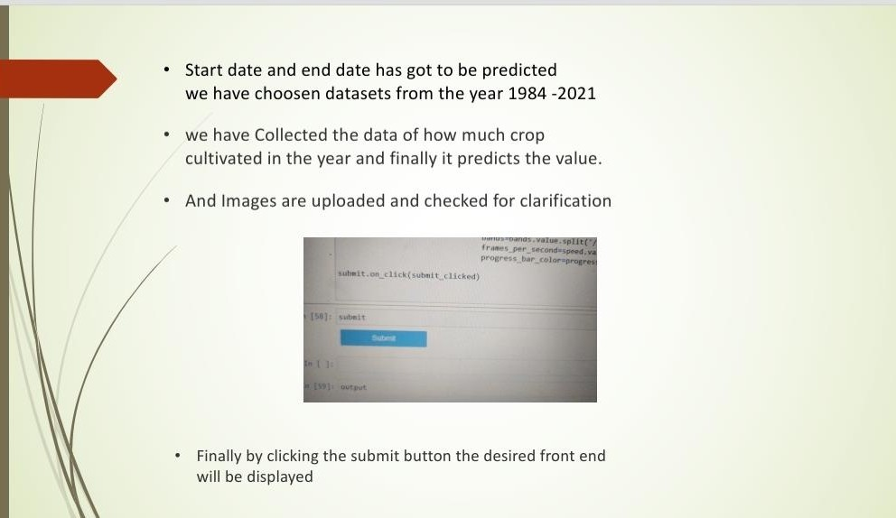

Slide 20
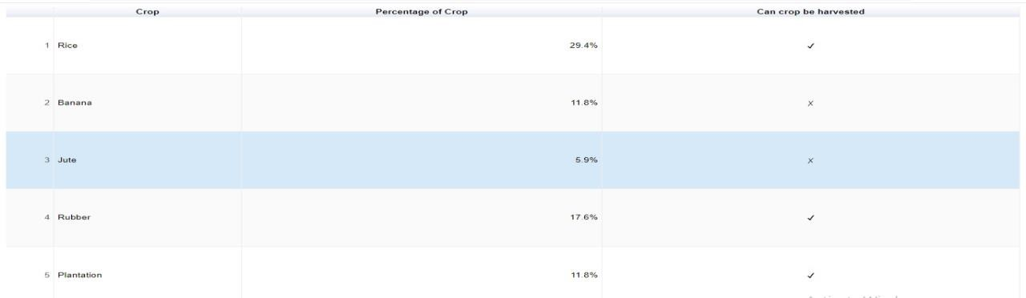
TABLE
The table tells us the the percentage of crop that can be harvested
The units are represented in percentage.
Rice has the highest percentage of crop of 29.4% that a crop can be harvested.
The jute crop cannot be harvested because it has the lowest percentage of crop.
Banana has 11.8% of crop and it cannot be harvested.
Compared to banana,rubber has the higher percentage of 17.6% of
crop so it can be harvested.

Slide 21
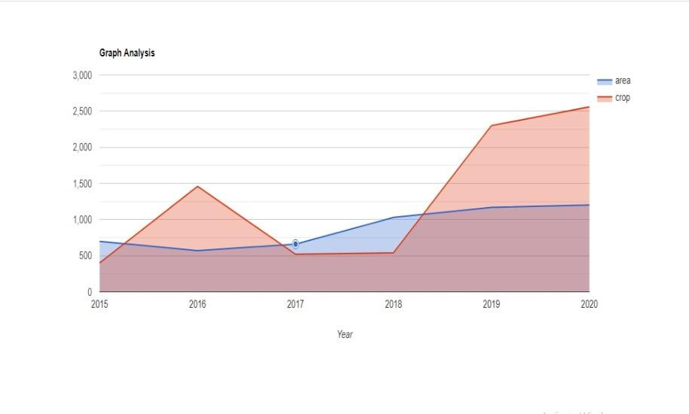
Graph analysis
The graph illustrate the crop production in a area for the particular year
The units are represented in hectares
The area of the crop is gradually from the year 2015 to 2020.
But there is a fluctuation in the production of the crop.
Here in 2015 the crop production is too low
But the production of crop shot up in the year 2016

Slide 22
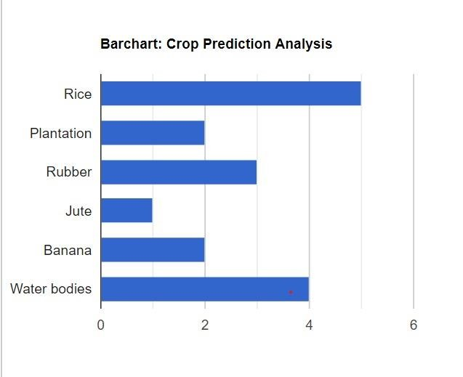
Then there is a slight drip in the year 2017
In 2017-2018 the crop production is gradually constant for the two years
There is a drastic increase in the crop production in the year 2019
BAR CHART
The Bar chart illustrates the area of production of crops (rice, Plantation, Rubber, Jute, Banana and Water bodies) in India.
Units are measured in hectare.

Slide 23
Overall, rice covers a large area in the period given. Both the area of Banana and Plantation was almost same.
whereas the least area occupied was Jute compared to Rubber in India.
Furthermore, the most significant is water bodies which covers the second highest area among all crops.
In terms of Rice, its occupies an area of 5 hectares . Similarly, the water bodies was higher of about 4 hectares but less than that of rice.
The difference between the area of both crops was exactly 1
hectare. Whereas the area of Jute occupied was 5 times less compared to area filled up by rice.
On the other hand, the area of Banana and Plantation was similar of about 2 hectares, which Is the second least area covered among all the crops.
Furthermore the area occupied by Rubber which was slightly more than Banana and Plantation covers almost 3 hectares

Slide 24
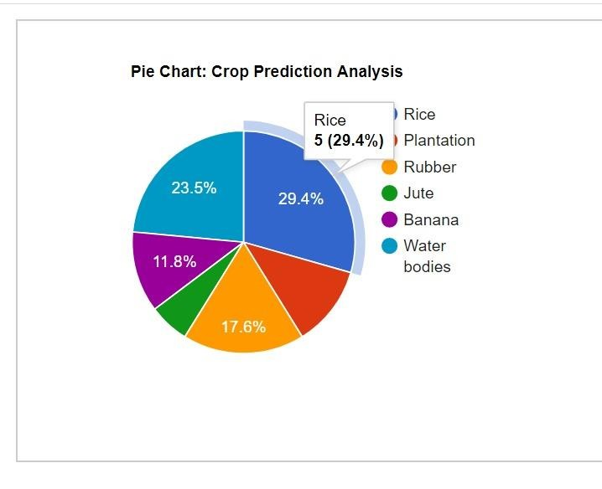
PIE CHART
The pie chart illustrate the proportion of six types of crop prediction analysis in India
.
The units are measured in Percentage.
Overall, the most significant crop production was rice and water bodies, which together accounted for over half the production of crops, while jute and other kinds of crops generated the least amount of production in India.
In terms of rice the production comprised of 29.4% whereas the water bodies has a percentage of 23.5%.
Both accounted for about 52.9% which covers half of the crop production.

Slide 25
With regards to the remaining crops, there was an approximate 10% and less 5% production from both plantation and jute respectively.
Rubber on the other hand, strikes 17.6% and finally the prodution of banana hit 11.8%.
CONCLUSION
Therefore our project demonstrates the crop growth analysis,field monitoring and helps the state to determine the budget.
A farmer will be aware of the tentative amount of production he will obtain from his field. This will help the policymakers of the state to determine the budget. If the production of a crop observes a declining trend then they can plan to implement the schemes at an early stage. This in return will save the state from shortage of a product.The required import and export of a product can also be determined. This will also help in monitoring the growth of healthy crops. Suggestive methods will help the farmer to increase the yield

Slide 26
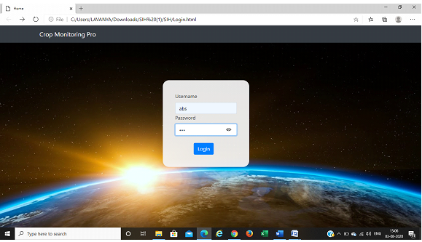
SNAPSHOTS OF OUR PROJECT
STEP 1: LOGIN CREDITIALS

Slide 27
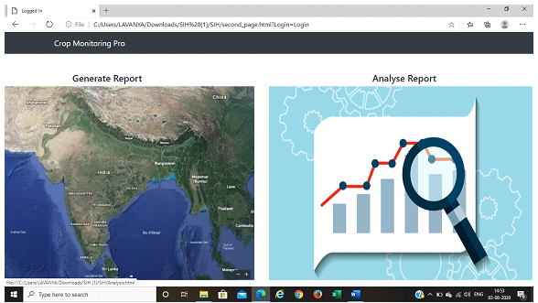
STEP 2: SELECTION OF ANALYSIS

Slide 28
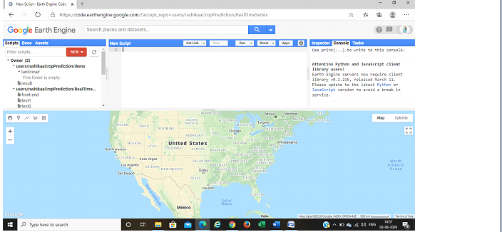
STEP 3 : GENERATE ANALYSIS

Slide 29
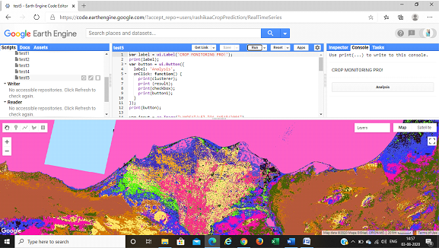
STEP 4: GENERATION OF ANALYSIS PROCEDURE FOR HUMAN UNDERSTANDING

Slide 30
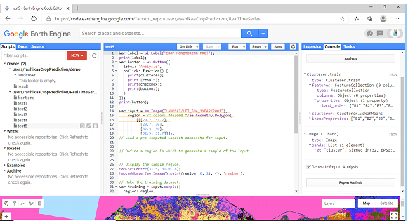
STEP 5 : ANALYSIS OF REPORT GENERATION

Slide 31
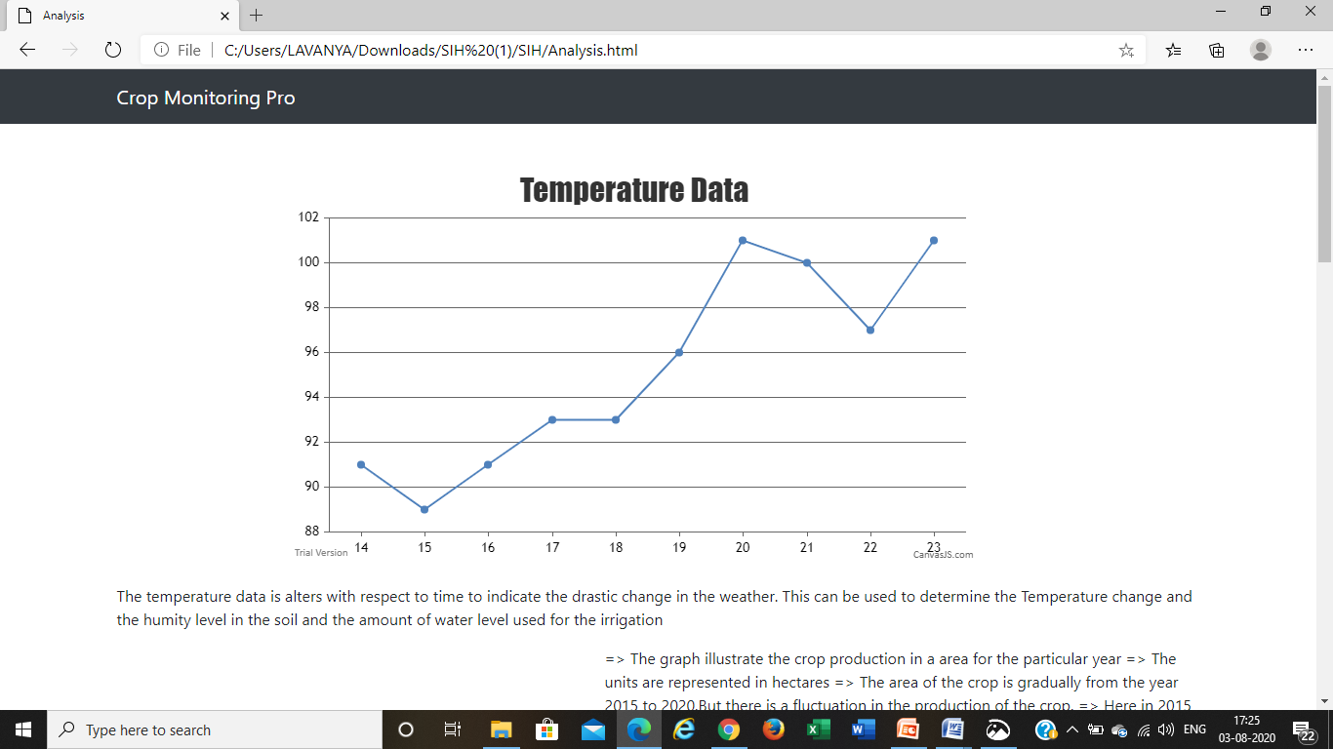
STEP 6: ANALYSIS REPORT GENERATED

Slide 32
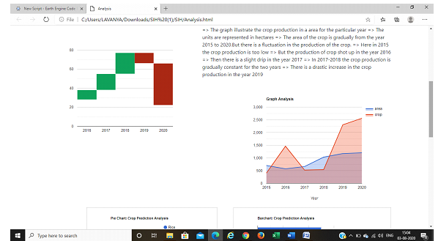

Slide 33
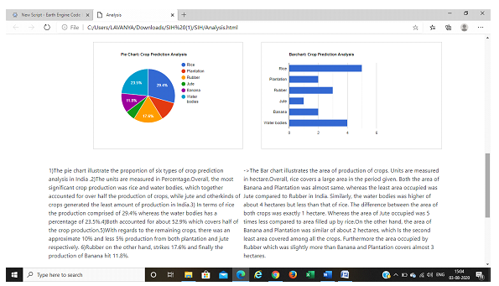

Slide 34
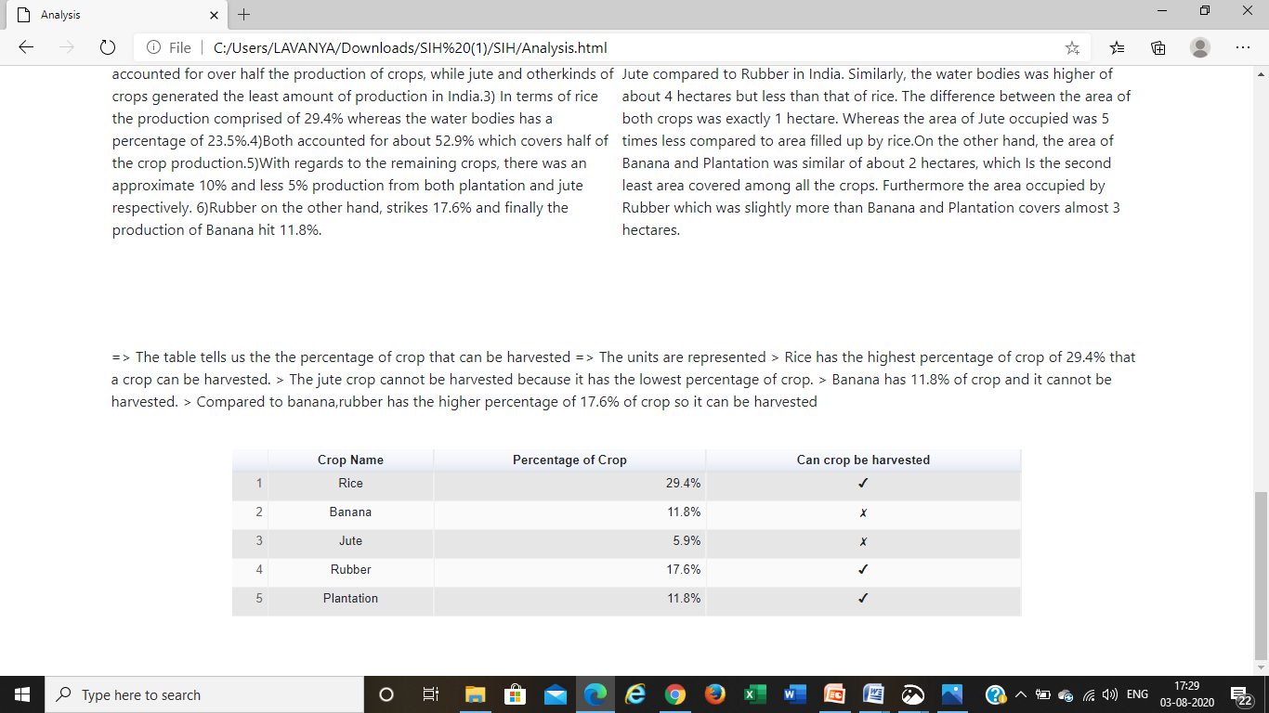

Slide 35
THANK YOU

